Slide 1
Bridges-2 Results
Parameter_sweep

Slide 3
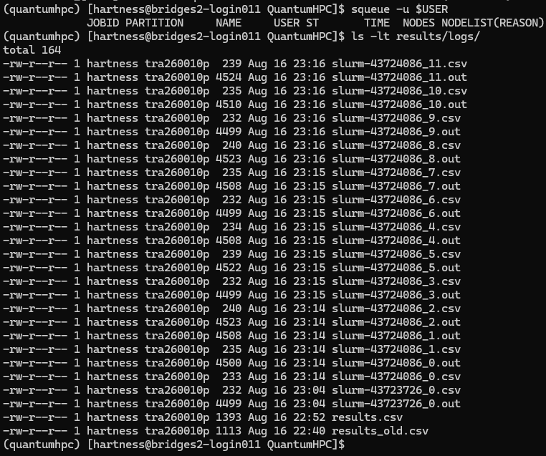

Slide 4


Slide 5


